Slide 1
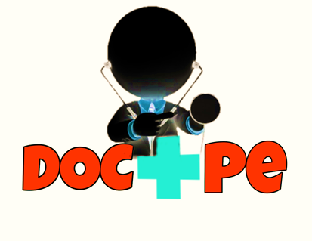
Online OPD Appointment Booking & Video Consultation System
PS Code : CM481
Team Name : DOC + PE
Team Leader : Sanket Bhoite
College Name : Government Polytechnic, Pune

Slide 2

CONTENTS
1. Problem Statement
2. Introduction
3. Process
4. Technology Stack
5. Features
6. Advantages
7. Conclusion

Slide 3

PROBLEM STATEMENT
Develope an application for booking inclinic and video appointment with the doctor and video consultation through online using a mobile.

Slide 4
INTRODUCTION
Patient can easily book an appointment without visiting a hospital.
After booking the appointment successfully the appointment slip will be send to the patient.
With the help of video consultation option doctor and patient can easily interact with each other.
with the help of online payment method patient will pay the doctor fee.

Slide 5





Process (Patient Side)
User installs the app
Create his/hers account fill
all details like username, password, Phone no, Email id etc. Stored in Firebase.
User Login into the app
user enter his/hers username and password and login into system.
My Profile
User can view his/her profile. They can also check the status of booked appointment
Video Consultation
User will enter the code which is received from doctor and start the video call.
Appointment Booking & Generating the appointment slip

Slide 6
Process (Doctor Side)
Doctor installs the app
Create his/hers account fill
all details like Username, password, Phone no, Email id , license no etc. Stored in Firebase.
Doctor Login into the app
Doctor enter his/hers username and password and login into system.
My Profile
Doctor can view and edit the profile.
Video Consultation
Doctor will start the consultation.
Show my appointments
All the doctor appointments will show

Slide 7



TECHNOLOGY STACK
FIREBASE
Database for storing the patients details, doctors details and for authentication.
JAVA
The main used of java in project was to defined the logic in various state
ANDROID STUDIO
By using the android studio platform we develop the doc + pe application successfully

Slide 8



FEATURES
Booking inclinic Appointment
Booking Video Appointment
Video Consultation
Online Payment

Slide 9
ADVANTAGES
Online OPD Appointment Booking & Video Consultation System
24/7 booking is available from anywhere any time.
2. organize your schedule better
3. Multiple locations and multiple doctors.
4.Your business is always available for reservations.
5. An online booking system will save your time .
6. Patient can easily contact with doctor without going hospital.

Slide 10
CONCLUSION
Thus we have successfully developed the smart mobile application “DOC + PE” helping the patient to book the doctor appointment from the mobile.
There is no need to visit the hospital and wait in queue until the doctor is available.

Slide 11


